Slide 1
Definition of Matrix
Name : Tushar Sarkar
ID: 18CSE035
Course Code: MAT205

Slide 2
What is Matrix ?
A matrix is a rectangular array of numbers. In other words, a set of „m‟, „n‟
numbers arranged in the form of rectangular array of m rows and n column is
called m×n matrix read as „m‟ by „n‟ matrix.
a₁₁ a₁₂ a₁₃… …
a₂₁ a₂₂ a₂₃… …
a₃₁ a₃₂ a₃₃… …
Horizontal lines
A =
M x N
Vertical lines

Slide 3






Horizontal Line
Vertical Line
We can understand matrix by the fig. shown above, which shows a mess of vertical and horizontal lines. The crossing points of vertical and horizontal lines are the position of elements of matrix. In above fig there are 9 crossing points which can be find out by multiplying no. of horizontal and vertical lines i.e. 3 × 3 = 9.

Slide 4
The numbers a₁₁, a₁₂ ……..etc are called elements of the matrix A. „m‟ is thenumbers of rows and „n‟ is number of column.
2 3 4
4
2 4 3
e.g. A= 5
6 3×3

Slide 5
Matrices are denoted by capital letters A, B, C or X , Y , Z etc.
Its elements are denoted by small letters a, b, c ….. etc.
The elements of the matrix are enclosed by any of the brackets i.e
( )
The position of the elements of a Matrix is indicated by the subscripts attached to the element. e.g. 𝑎13 indicates that element „a‟ lies in first row and third column i.e. first subscript denotes row and second subscript denote column.
Element
Indicate Row
^{𝑎}1 3
Indicate Column

Slide 6
Order of Matrices
The number of rows and columns of a matrix determines the order of the
matrix.
Hence , a matrix , having m rows and n columns is said to be of the order
m × n ( read as f ‘m’ by ‘n’).
In particular, a matrix having 3 rows and 4 columns is of the order 3 × 4
and it is called a 3 × 4 matrix e.g.
A=
2 3 5
4 6 7
is a matrix of order 2 × 3 since there are two rows and three
columns.
A = 3
5 7
is a matrix of order 1 × 3 since there are one row and three
columns.
5
is a matrix of order 3 × 1
A = 6
since there are three rows and one
8
column.

Slide 7











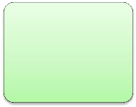
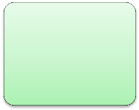

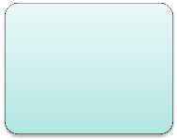








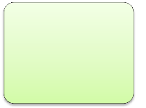
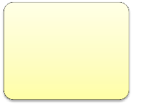
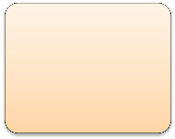




Types of Matrix
Rectangular Matrix
Square Matrix
Diagonal Matrix
Scalar Matrix
Column Matrix
Row Matrix
Null Matrix
Unit Matrix
Upper
Triangular Matrix
Lower Triangular
Matrix
Sub Matrix

Slide 8
Rectangular Matrix : A matrix in which the number of rows and
columns are not equal is called a rectangular matrix e.g. ,
A= ²
4
4 6 7
⁵ 2 × 3 is rectangular matrix of order 2×3
Square Matrix : A matrix in which the number of rows is equal to the number of columns is called a square matrix e.g.
Principal Diagonal
 | 2 | 3 | 4
𝐴 = | 3 | 2 | 5
 | 7 | 8 | 5
Note : The elements 2, 2 , 5 in the above matrix are called diagonal elements and the line along
which they lie is called the principal diagonal

Slide 9
Diagonal Matrix : A square matrix in which all diagonal elements are non- zero and all non-diagonal elements are zeros is called a diagonal matrix e.g.
2 0 0
2 0 is a diagonal matrix of 3 × 3 0 0 5
𝐴 = 0
Scalar Matrix : A diagonal matrix in which diagonal elements are equal
(but not equal to 1), is called a scalar matrix e.g.
2 0 0
2 0 is a scalar matrix of 3 × 3 0 0 2
𝐴 = 0
Identity (or Unit) Matrix : A square matrix whose each diagonal element is unity and all other elements are zero is called and Identity (or Unit) Matrix. An Identity matrix of order 3 is denoted by I₃ or simply by I.

Slide 10
 | 1 | 0 | 0
I₃ = | 0 | 1 | 0 | is a unit matrix of order 3
 | 0 | 0 | 1
Null (Zero) Matrix : A matrix of any order (rectangular or square) whose each of its element is zero is called a null matrix (or a Zero matrix) and is denoted by O. e.g.
0 0
0 0 0 0 0
O = ⁰ ⁰ and O = ⁰
are null matrices of order 2 × 2 and 2 × 3
respectively.
Row Matrix : A matrix having only one row and any number of columns is called a row matrix (or a row vector) e.g.
𝐴 = 1 2 3 is a row matrix of order 1 × 3

Slide 11
Column Matrix : A matrix having only one column and any number of
rows is called a column matrix (or a column vector) e.g.
1
A = 3 is a column matrix or order 3 × 1 6
Upper Triangular and Lower Triangular Matrix: A square matrix is called an upper triangular matrix if all the elements below the principal diagonal are zero and it is said to be lower triangular matrix if all the elements above the principal diagonal are zero e.g.
UTM
Sub Matrix : A matrix obtained by deleting some rows or column or both
of a given matrix is called its sub matrix. e.g.
𝐴 = | 2 0 | 3 1 | 4 5 | , | LTM 𝐵 = | 5 8 | 0 7 | 0 0
 | 0 | 0 | 7 |  |  | 4 | 3 | 1
2 3 4
𝐴 = 5 1 5 , Now
2 3
3 9
is a sub matrix of given matrix A. The sub
3 9 7
matrix obtained by deleting 2nd row and 3rd column of matrix A.

Slide 12
Application of Matrix in Computer Science
Matrices are used for making Graphics and for Creating and modifying Images.
Images are a collection of points, in this case matrix co-ordinates are used to represent these points.
The Images formed can be further transformed or mutated by changing these co ordinates.
Matrices are also used for encryption/decryption of codes or messages.

Slide 13
Matrices are also used for creating 2 Dimensional and 3 Dimensional Graphical images.
The accumulated collection of these points after being modified generates the final image , this is also known as rendering.

Slide 14
Thank You

